Slide 1
Lecture 5: Numerical linear algebra

Slide 2
Introduction
Very often, one need to solve (ex: regression)
Ax=b
A matrix
X unknown vector
b vector of scalars
Requirement
The algorithm solving the problem should be
Efficient
Numerically stable

Slide 3
Linear regression models
Minimize
Solve the equation system that can be written
where is a matrix of observed x-variables

Slide 4
Smoothing splines
Minimize
Solution is
where θ is found from

Slide 5





Solving system of linear equations
Therefore, it is important to solve Ax=b
Aware of computer arithmetic! (recall a+x=x)
Condition number
Original system
Perturbed system
Solution is good if small perturbation of b causes small perturbation of x, and since

Slide 6


Solving system of linear equations
Condition number
Properties:
Large condition number is a bad signal, but does not imply ill-conditioning
If norm is L₂ then k is ratio of max.eigenvalue and min.eigenvalue
Since problems in regression fitting may appear

Slide 7
Gaussian elimination and LU decomposition
Basic idea
Consider the equation system where A is a square nonsingular matrix
Set
Form
and continue to eliminate variables one by one

Slide 8


Gaussian elimination and LU decomposition
Two stages
Forward reduction
Back substitution
Forward reduction
Replacement
Row interchange (if after k steps a_{kk} becomes zero)

Slide 9
Gaussian elimination and LU decomposition
Forward reduction, equivalent elementary operations:
Replacement
Introduce E=I and replace e_{jk} by c (this is a lower triangular!)
Row interchange
Introduce E=I and interchange rows j and k
!Elementary operations transform the system as
EAx=Eb

Slide 10


Gaussian elimination and LU decomposition
Forward reduction, numerical issues:
Real a_{kk}=0, but computer a_{kk} became a small number -> interchange not happening
If dividing by a_{kk}, Inf may be obtained
Example: 4 digits after comma
-> partial pivoting, choose the equation that gives

Slide 11


Gaussian elimination and LU decomposition
Back substitution
Comments
Complexity O(n³)
For all elementary operations, the reverse matrices are easily found

Slide 12
Gaussian elimination and LU decomposition
After gaussian elimination (if no permutations),
If permutations are involved,

Slide 13
LU decomposition
Applications of LU
Solving system of equations
Inverse matrix
Determinant
det(A)=det(L)*det(U)=product of diagonal el-s

Slide 14


QR decomposition
A can be decomposed
Q orthogonal
R upper triangular (trapezoidal)
If A=m x n , m>n,

Slide 15
QR factorization
Use of QR in regression (see proof…)
R is upper triangular -> inverse by back substitution (fast)

Slide 16

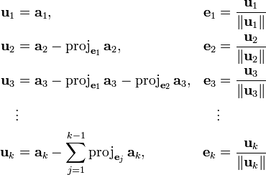
How to do QR
Gram-Schmidt orthonormalization

Slide 17
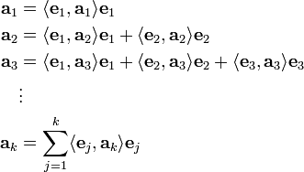
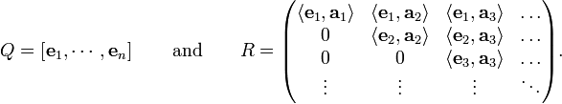
How to do QR
→ A=QR, Q-orthogonal

Slide 18
Cholesky decomposition
For symmetric and positive definite A,
A=T^{T}T
T upper triangular
T is sometimes called square root
There is a simple algorithm (see book)
Cholesky decomp. algorithm is numerically stable
Complexity O(n³)
Only one matrix with n(n+1)/2 elements needed for decomp.

Slide 19
Cholesky decomposition
Applications:
Solving Ax=b (see how I goes…)
Nonlinear optimization (quasi-newton methods, next lecture)
Generating correlated variables:
Suppose we need to generate N(μ,Σ):
Take i.i.d. N(0,1) sequence X=(X₁,…X_{n})
Compute Cholesky factor or matrix square root, i.e. matrix A: AA^{T}= Σ
Compute Y as μ+AX
Observe: EY= μ, cov(Y)=AA^{T}

Slide 20
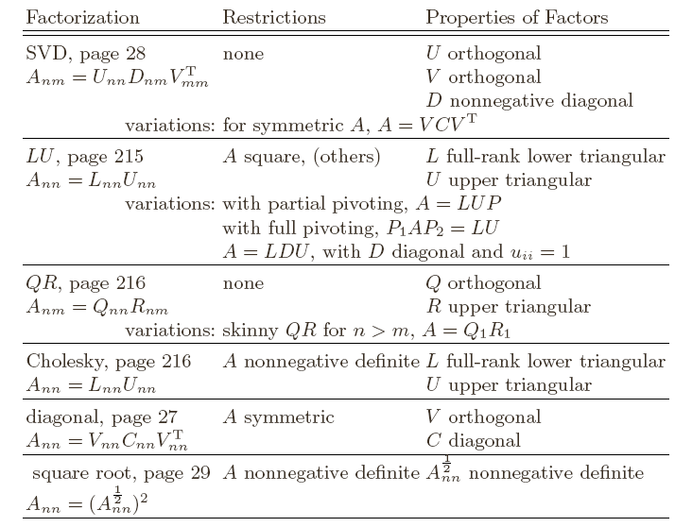
Other decompositions

Slide 21

Conjugate gradient method
Solving Ax=b is equivalent to minimizing
General scheme for iterative methods:
Choose starting point x⁽⁰⁾, i=1
Choose direction p^{(i)} and scalar α^{(i)}
Update x^{(i)}= x^{(i-1)}+ α^{(i)} p^{(i)}
Until convergence

Slide 22
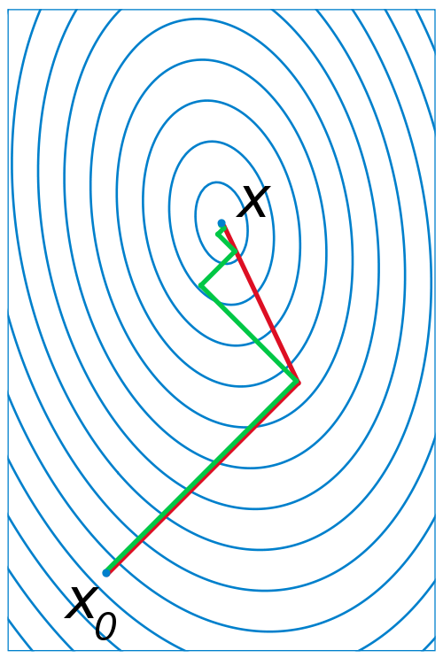

Conjugate gradient method
Directions are conjugate if
Why do we need CG method?

Slide 23
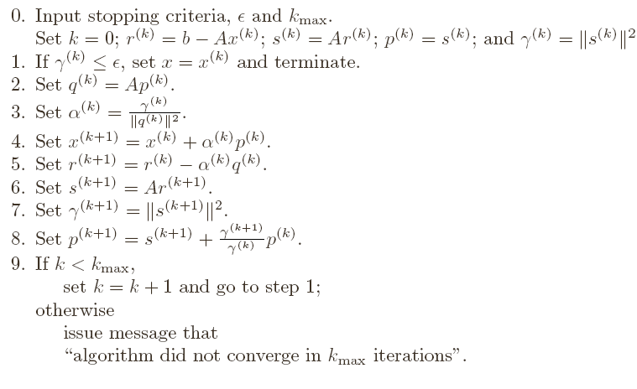
Conjugate gradient method
Finding of conjugate directions is done directly in the algorithm:

Slide 24
Conjugate gradient method
Comments
Most appropriate for large (sparse) A, nxm>=1000x1000
Converges in n iterations
In computer arithmetic, may take more time

Slide 25
Reading
Chapter 5
Wikipedia

